Slide 1
Electronics II
EEET - 222
Lab #4
Operational Amplifier Parameters
RCC-13

Slide 2
Lab #4 Objectives
Measure the input offset voltage.
Measure the input bias current.
Measure the input offset current.
RCC-13

Slide 3
Prelab
  The following problems and appendices can be found in “Operational Amplifiers with Linear Integrated Circuits” by Stanley, Fourth Edition.
  Complete problems 3-21 (part c only). Scans of the problems have been added to the end of this lab (for reference only). Use your book first since the quality of the scans may make some of the values hard to read.
  Complete problems 3-22 (part c only).
  Lookup, and record in Table #1, the Input Offset Voltage, Input Offset Current and Input Bias Current values found in Appendix C.
RCC-13

Slide 4
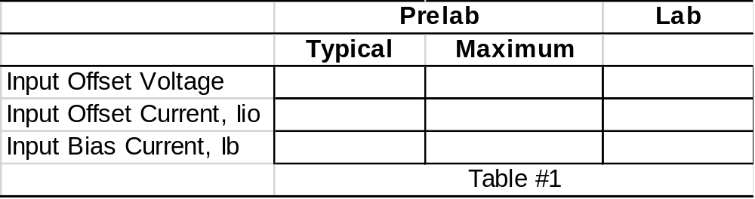
Data Table
For Ib (bias current), please enter the average of Ib+ and Ib-.
RCC-13

Slide 5
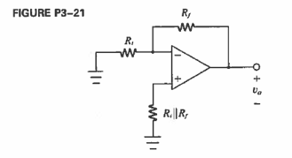
Procedure
Refer to “Operational Amplifiers with Linear Integrated Circuits” by Stanley, Fourth Edition.
Complete Laboratory Exercises (LE) 3-3, part 1, and place results in Table #1. Apply +/- 12V to the power pins. For R_{I} || R_{F} use a single resistor that is close to the desired value. Do not use a decade box as the extra wires add a lot of noise.
RCC-13

Slide 6
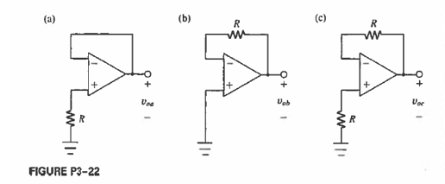
Procedure
Refer to “Operational Amplifiers with Linear Integrated Circuits” by Stanley, Fourth Edition.
Complete LE 3-4, part 1, and place results in Table #1. Apply +/- 12V to the power pins. Get a sign off.
RCC-13

Slide 7
Report
Cover sheet
Write a 100 word summary. Include the following:
  Define the input offset voltage, input offset current and input bias current.
Computer generated data table with prelab and lab offset and bias values.
Sign-off sheet.
RCC-13

Slide 8
OpAmps Parameters
Lab 4 Sign-offs
Name _____________________________________ Input offset voltage
Input bias current
 |  | / /
Signature |  | Date
 |  | / /
Signature |  | Date
RCC-13

Slide 9
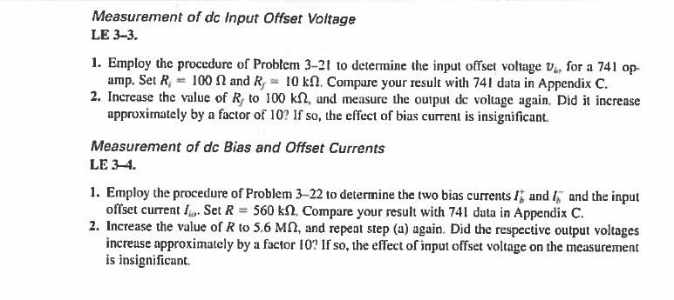
RCC-01

Slide 10
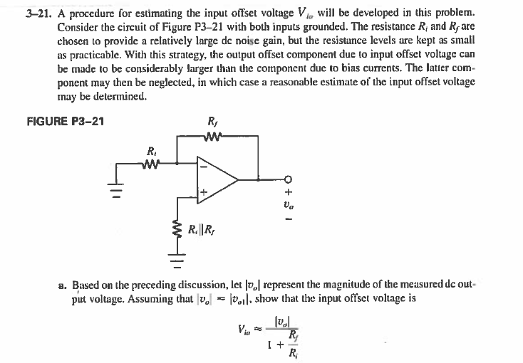
RCC-01

Slide 11
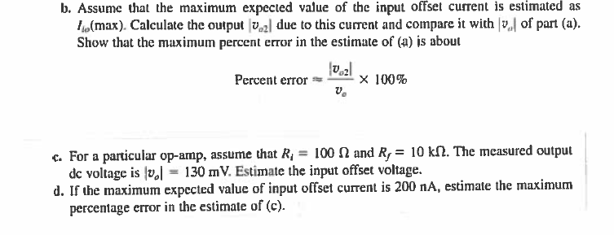
RCC-01

Slide 12
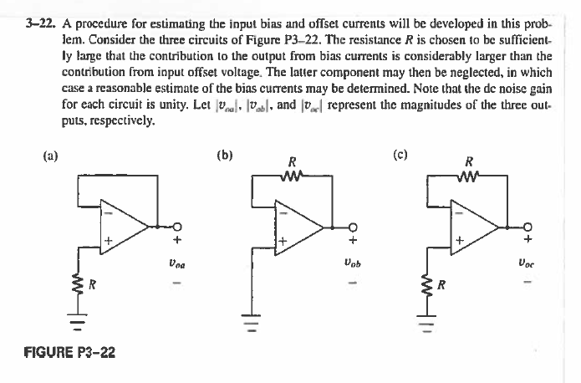
RCC-01

Slide 13
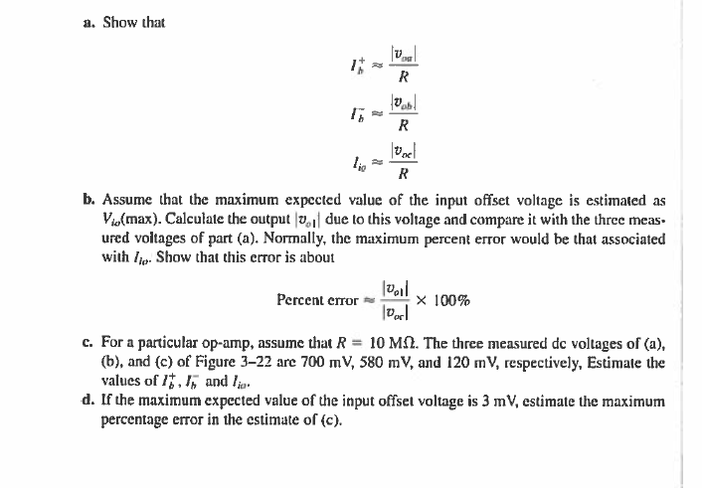
RCC-01

